Slide 2
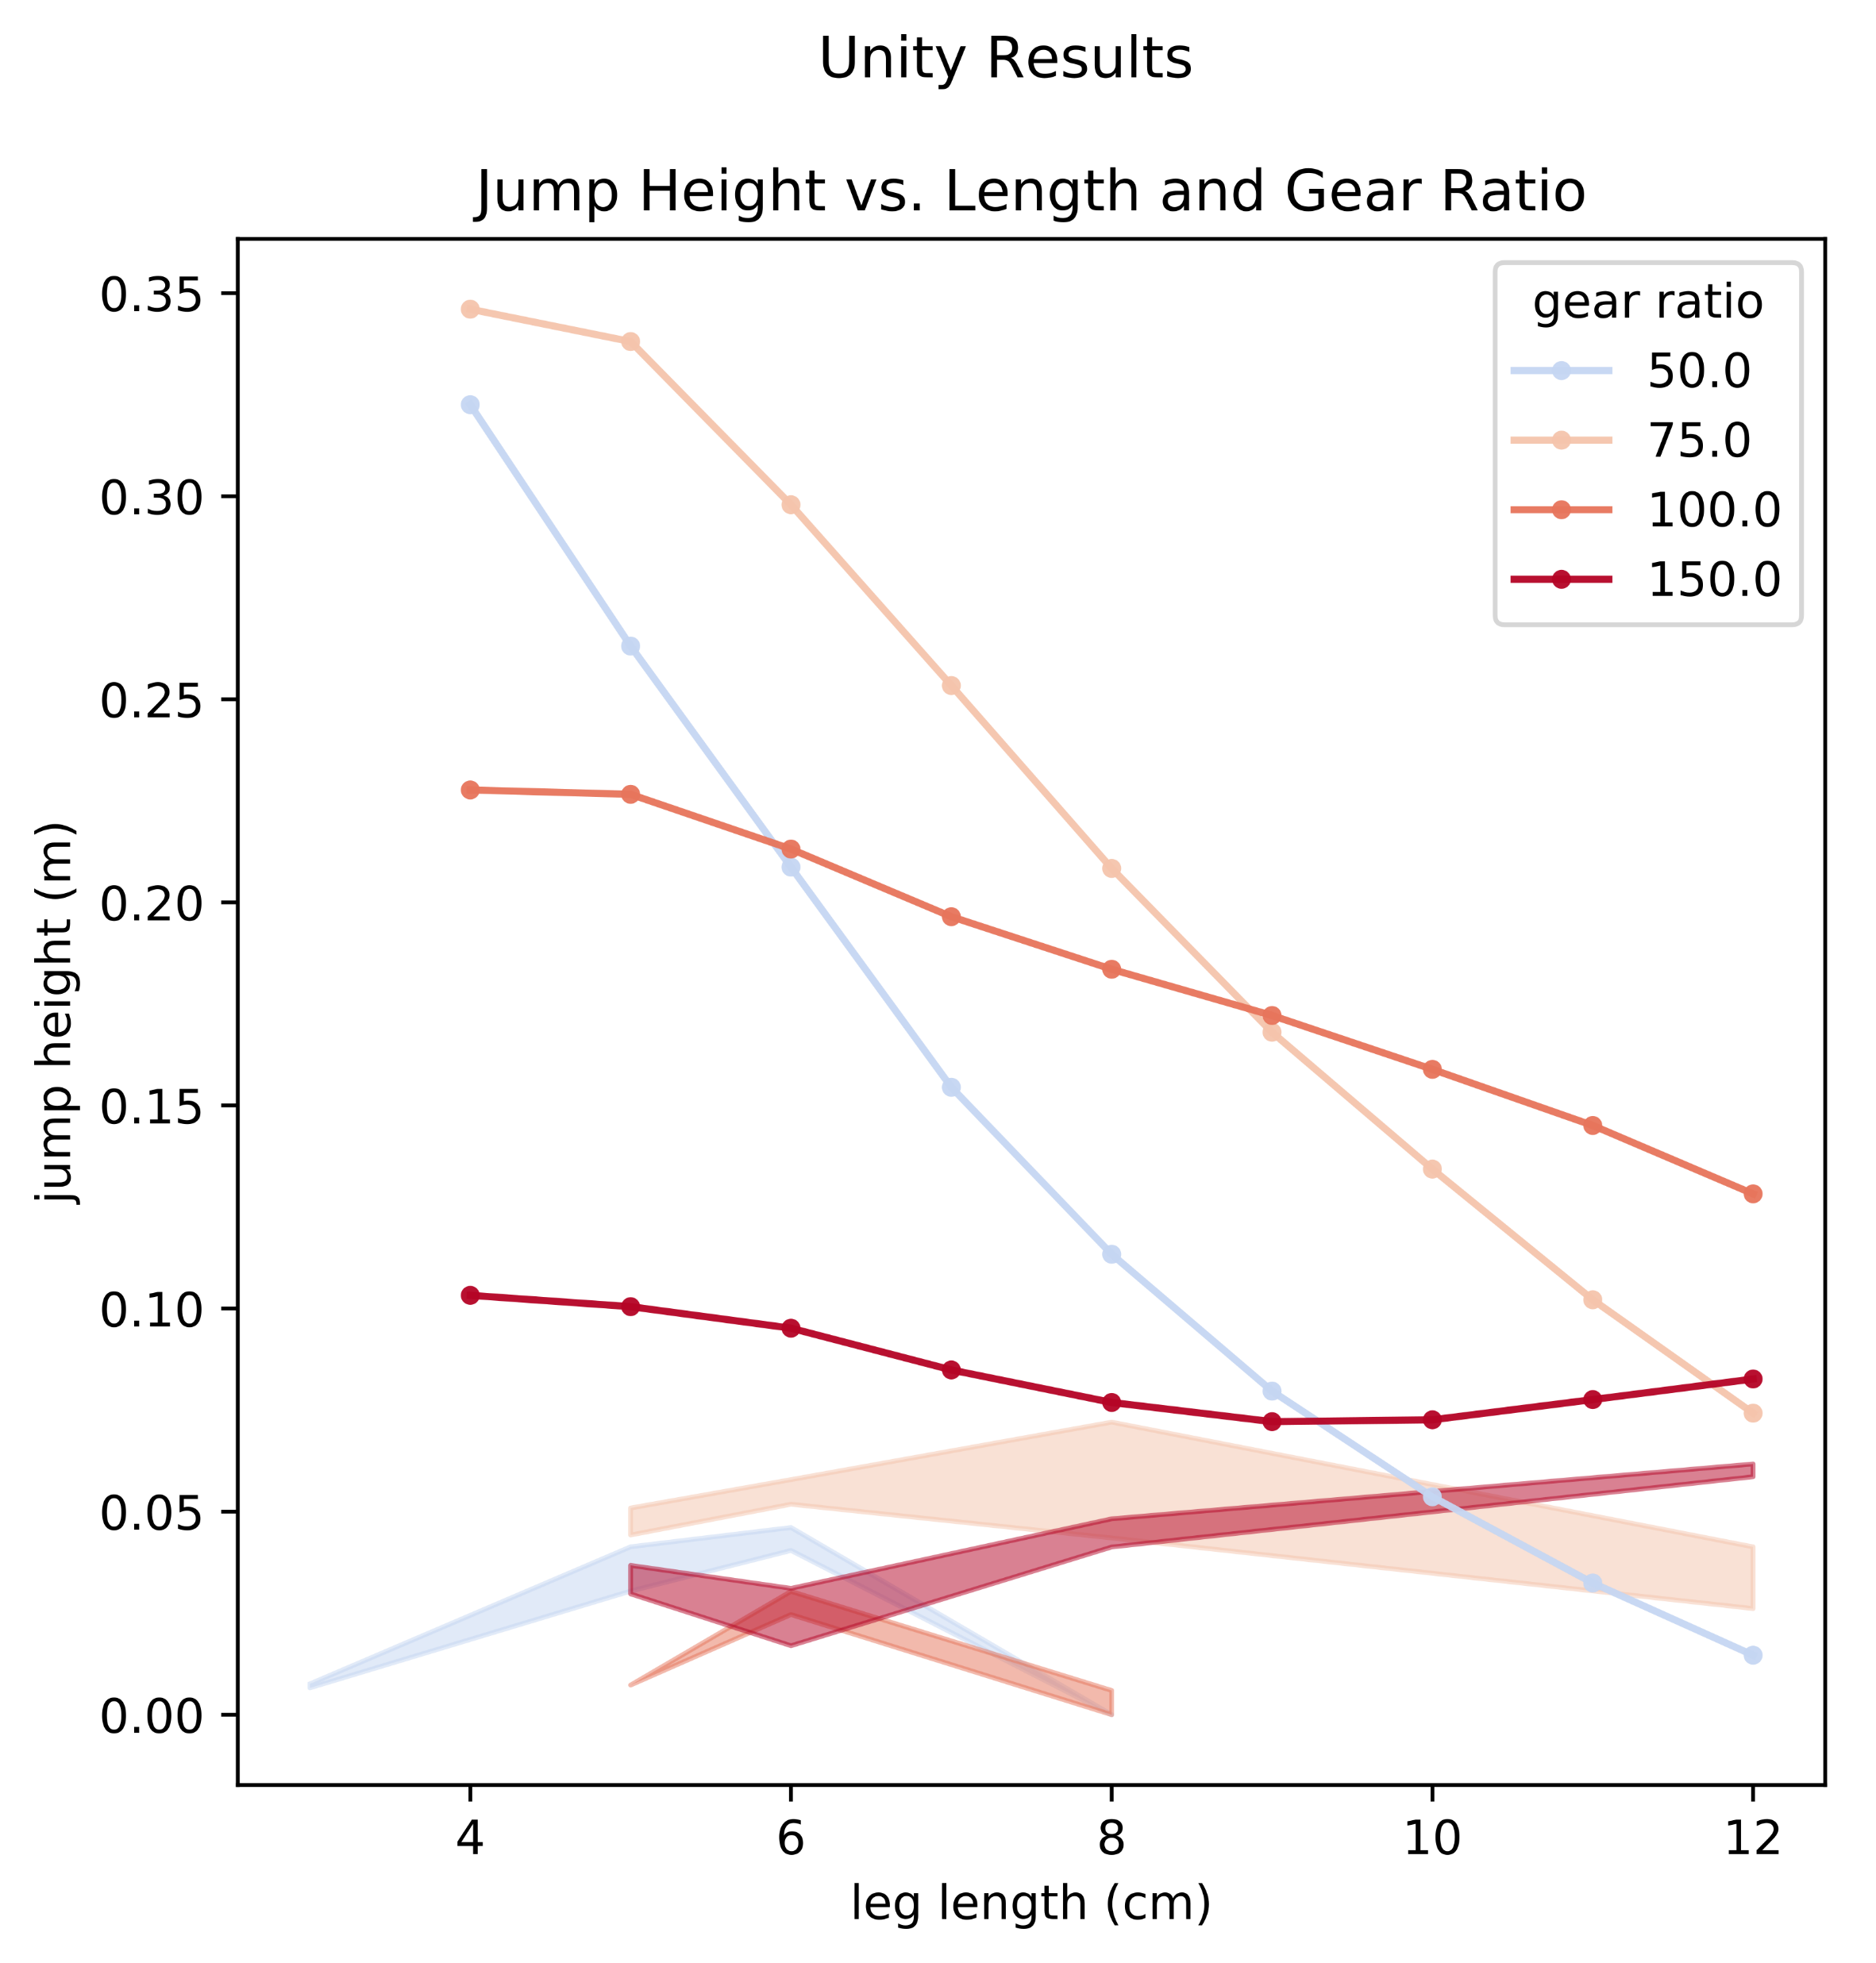

Slide 3
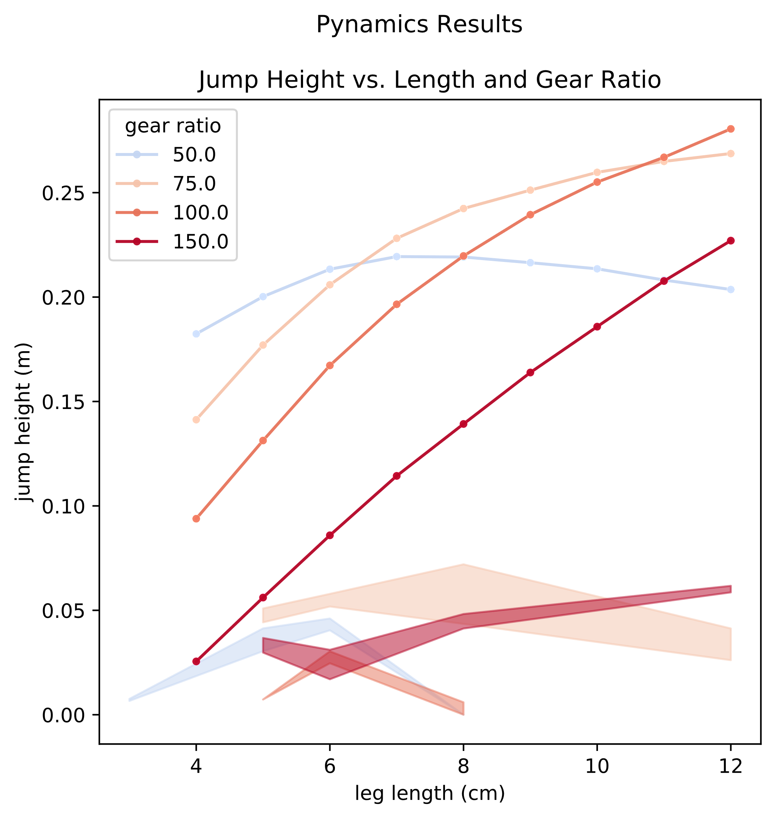
Notes:
Rerun 100:1 (or all with same motor)
Discussion about trends and design relationships
Benchmark test Unity – spinning flying cube, contacts, springs (w/ and without scaling)
Motion Genesis

Slide 4
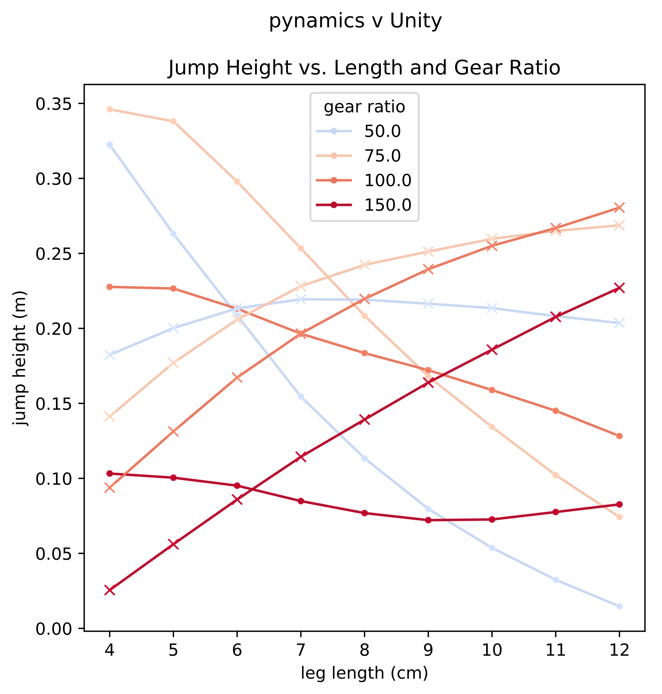

Slide 5
